Slide 1
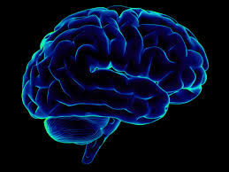

Assembly Elections 2018
Practicum Project 1
Project Members
Navya Y(PGID: 11810063)
Akhilesh KVS(PGID:11810115)

Slide 2
Agenda
Summary
Business Problem
Data Requirements & Data Collections
Data Understanding
Data Preparation
Modeling, Evaluation and Feedback
Business Recommendations
Assumptions, Limitations & Further Work

Slide 3
Executive Summary
Motivation: An aspect of social media data such as Twitter messages is such rich structured information about individual opinion. It can lead to more accurate results for extracting semantic information. Track and analyse the election chatter that happens in Twitter, Facebook and other social medial channels.
Method: Built sentiment analysis on Twitter election data.
Models: NLTK Sentiment Intensity Analyzer and LDA
Message: Predicted Telangana Election result 2018, based on polarity of the tweets. Topic Modelling on positive and negative set of tweets to get the insights for being positive or negative
Business Recommendations: promote political campaign, understand public views and make smarter decision.
Means: Spyder, Twitter API and selenium to scrape the data, topic modelling using LDA, Python and NLTK

Slide 4
Business Problem
Business Understanding
Analyse trends and patterns of election chatter happens in twitter or any other social media and predict the outcome of the Telangana Elections 2018. Sentiment analysis helps to get the public opinion to announce policy announcement and campaign messages ahead of elections.
Analytics Approach
Data Collection (Individual Parties) Data Pre-processing Sentiment analysis on two major parties(TRS and Prajakutami) Polarity Trend Topic modelling
Connecting the dots using CBA courses studied.
Data collection, Text Analytics
Sentimental analysis is useful to provide deep insight into how people opinion, Thus it enables government of India to track the public political views & present how the political views on the top election candidates.

Slide 5
Data Requirements & Collections
Data Requirements
Twitter messages or Tweets are rich structured information about the individual opinion.
Twitter are short messages, restricted to 140 characters in length. Due to nature people will use emoticons/emoji’s and other special characters that express their feelings.
Data Collections
Twitter developing account with API key
Twitter data scrapping with Selenium.
Limitations
Tweets from Twitter is restricted to certain limit.
Noise in data.
Data inconsistency.

Slide 6
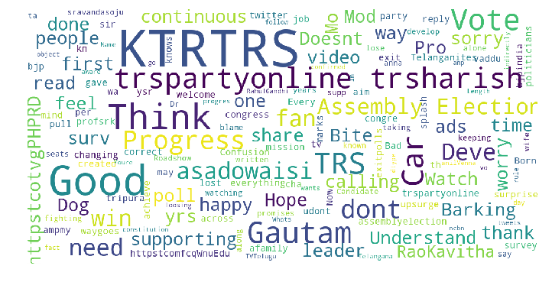
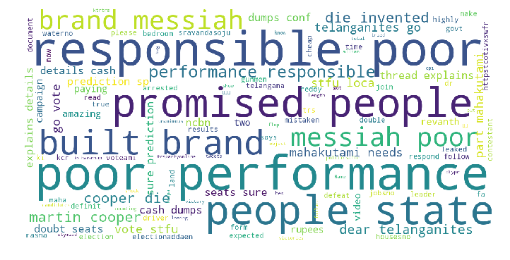
Data Understanding
Data Understanding
Data Summary: Wide verity of data with different Hashtags for different parties are considered, the data is collected separately for each individual party(TRS and Prajakutami)
Word Cloud for TRS Word Cloud for Prajakutami

Slide 7
Data Preparation
The data have HTML tags, Emoticons, Hashtags, Special characters, digits.
Since NLTK sentiment Intensity analyzer deals directly with text, Conversion of text to numeric is not required.
NLTK for text preprocessing such as removing punctuations, special character’s, digits, emoticons.
After performing all the above operations we get cleaned text which can be given as input to the model.
Date type conversion and considering tweets which are posted prior to election day.

Slide 8
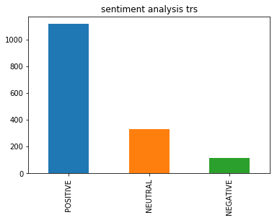
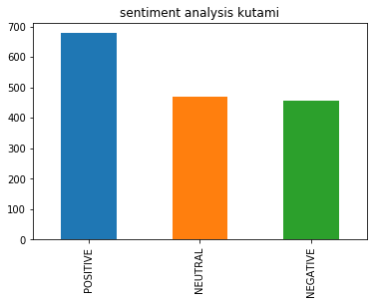
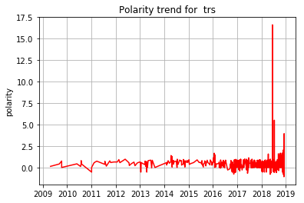
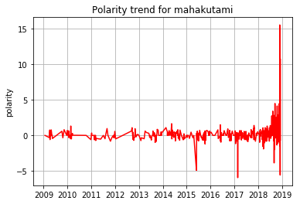
Model building
NLTK is a package with various functionalities which are designed for text analysis. It classifies the text to positive sentiment, negative sentiment or neutral using hieratical classification.
Based on polarity for each tweet, it get classified to sentiment.
By considering each party’s positive, negative tweets separately we built topic modelling which give insights behind the tweet to be negative or positive.
Built topic modelling on each party’s negative and positive tweets to get the public view about negatives and positives of the individual party.

Slide 9
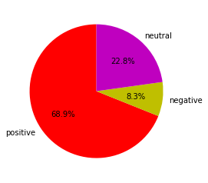
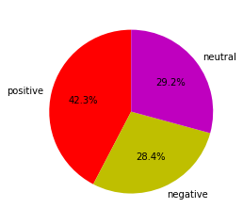
Business Recommendations
PTRS
Based on prediction the TRS party has more majority than the Prajakutami. Our model predicted 68.9% chance TRS would win in the more assembly elections in the general election due to positive sentiment they received in tweets.
Sentiment analysis on elections to promote the political campaign during elections & give public opinion towards the respective party’s.
During elections few of the news media will be biased, supporting some political parties and its agendas by influencing people. To avoid such circumstances sentiment analyses could be a useful tool to evaluate political news.
PPrajakutami

Slide 10
Assumptions, Limitations & Further Works
Assumptions and Limitations
We have taken Election data prior to the election day. There are only two major parties in Telangana, Most of tweets are related to these two major parties.
We didn’t consider emoticons. Since the data was around 2500 for each individual party. Which is not large enough to provide more accurate result were as in future we can increase size of the data.
Future Work
There could be many other prospective area to conduct research in, including the data from other social media sites fb, to increase size of dataset and machine learning algorthims can be applied for text classification and future prediction.

